Slide 1
Canada Car Accident 1999 - 2014
Boris Korotkov
Chaewon Kim
Patricia Luo
Ryan He

Slide 2
Canada Car Accident 1999 - 2014
Data Preparation
Analysis
Conclusions
Appendix

Slide 3
Data Preparation - Data Source

Slide 4
Data Preparation - Data Quality

Slide 5
Data Preparation - Data Loading & Preparation

Slide 6
Data Preparation - Challenge Faced

Slide 7
Canada Car Accident 1999 - 2014
Data Preparation
Analysis
Conclusions
Appendix

Slide 8
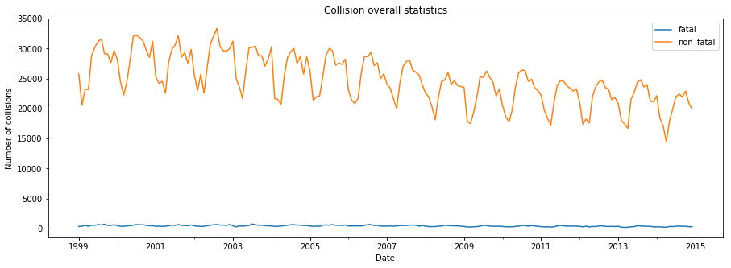
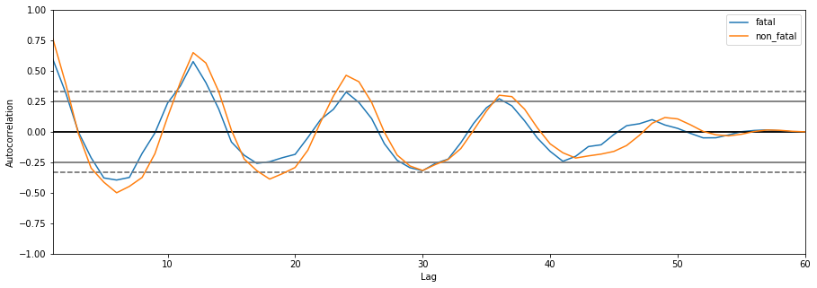
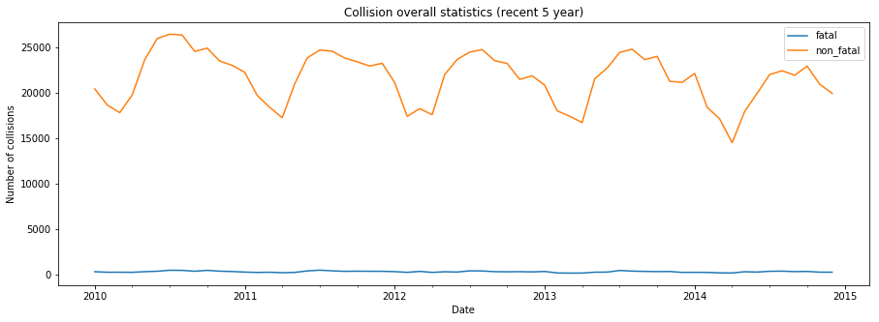
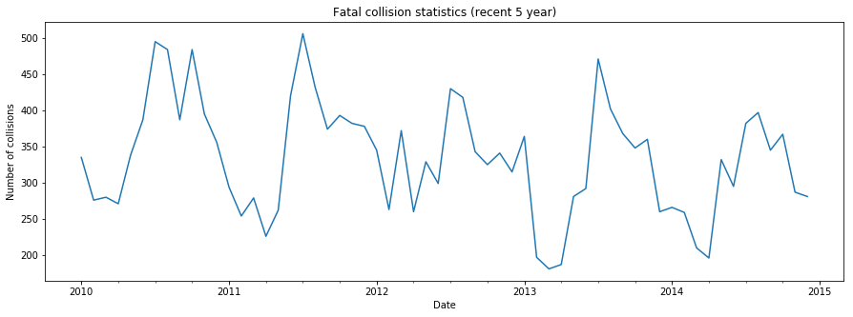
Analysis - 1. Fatal and Non-Fatal Collision

Slide 9
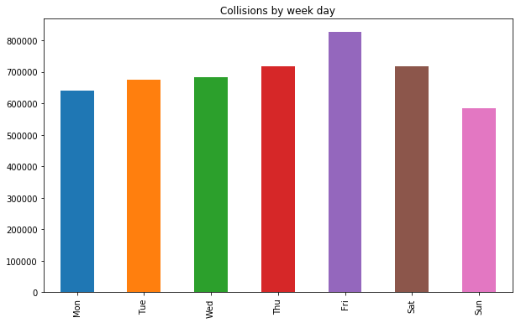
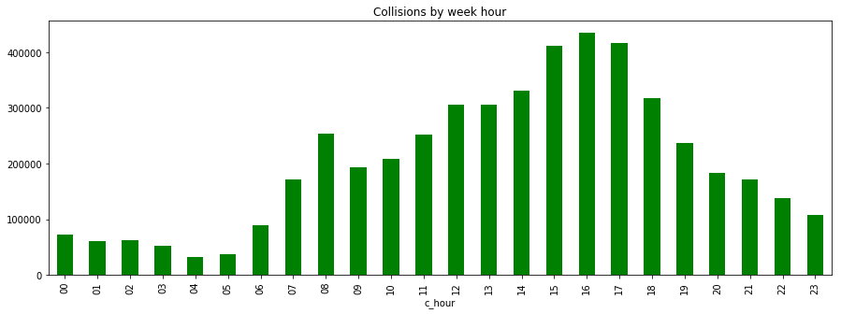
Analysis - 2. Collision Risk by Week Day and Day Hour
Day Hour
Week Day

Slide 10
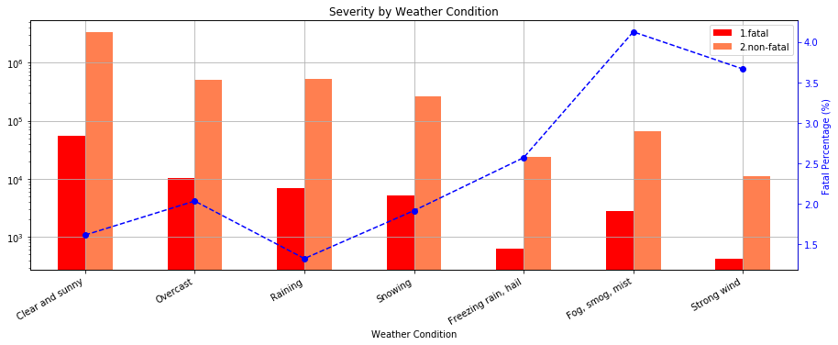
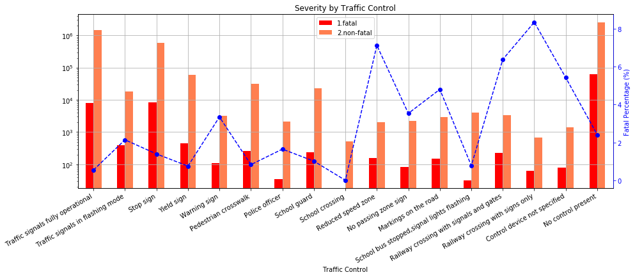
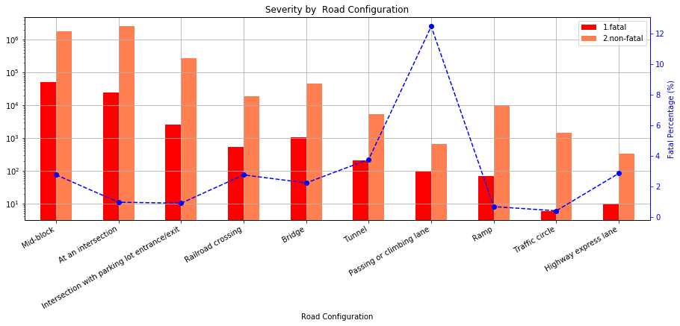
Analysis - 3. Road configuration, weather and traffic control

Slide 11
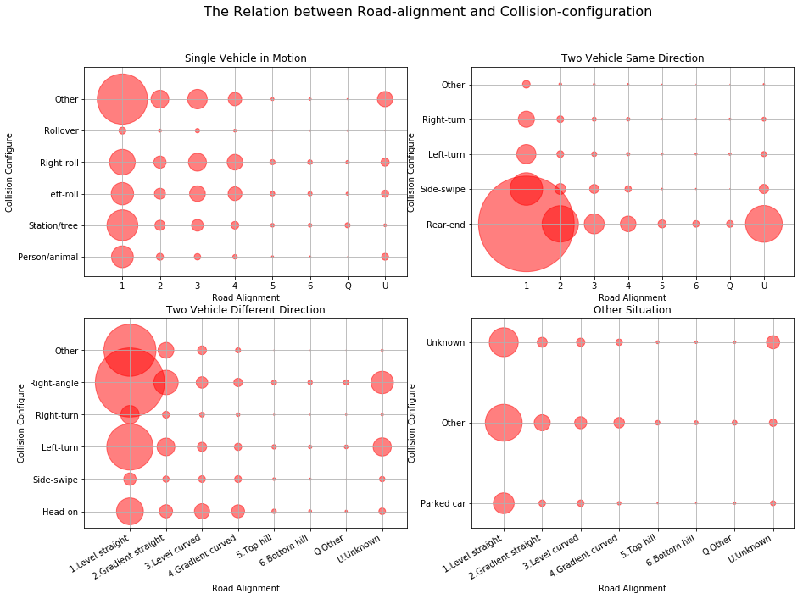
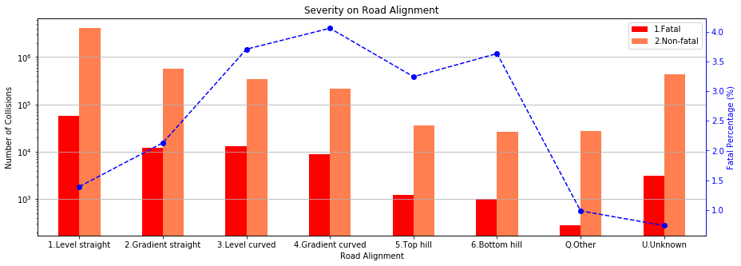
Analysis - 4. Road Alignment

Slide 12
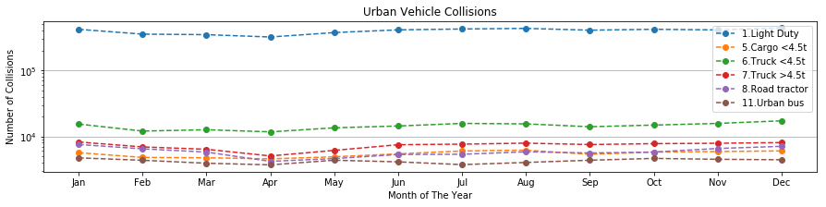
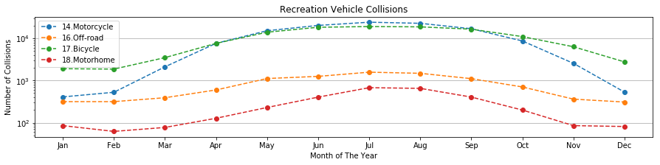
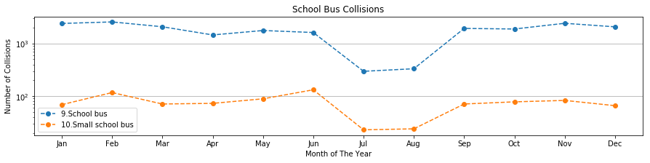
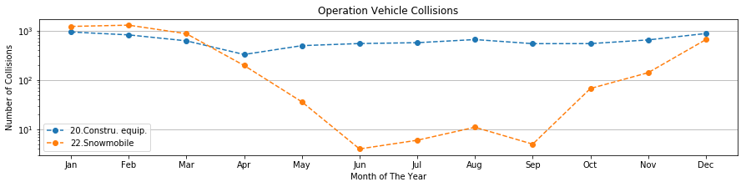
Analysis - 5. Vehicle Type

Slide 13
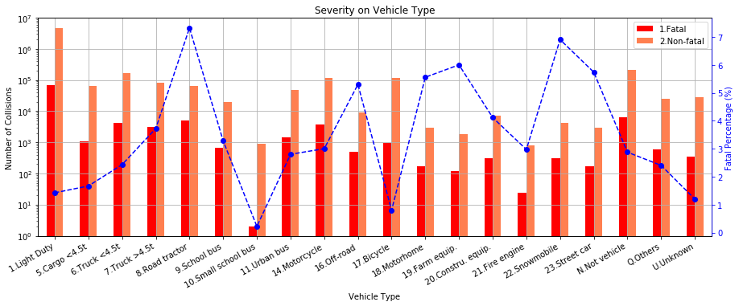
Analysis - 5. Vehicle Type & Severity

Slide 14
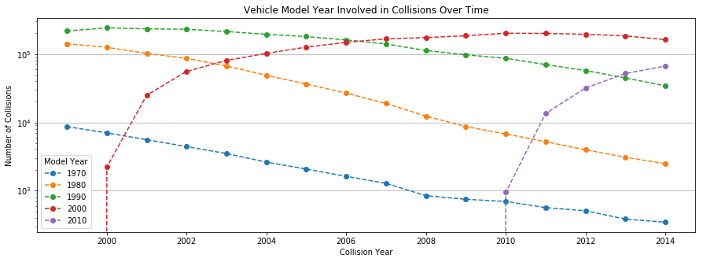
Analysis - 6. Vehicle Model Year

Slide 15
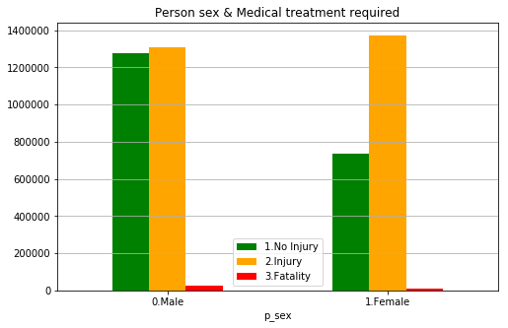
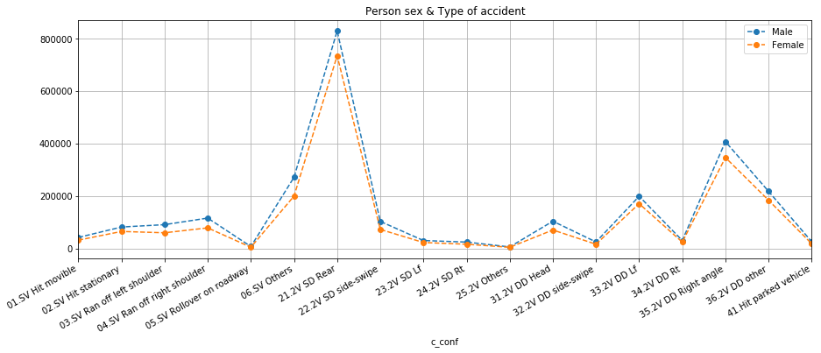
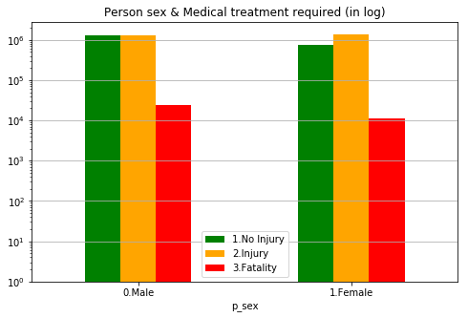
Analysis - 7. Person sex

Slide 16
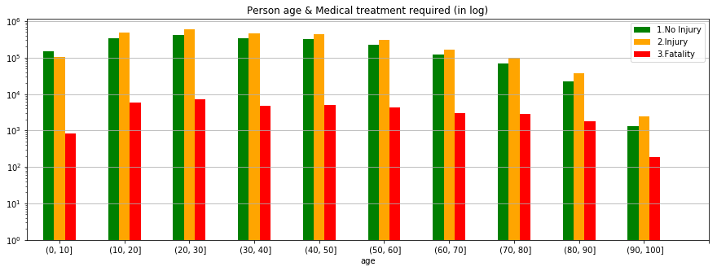
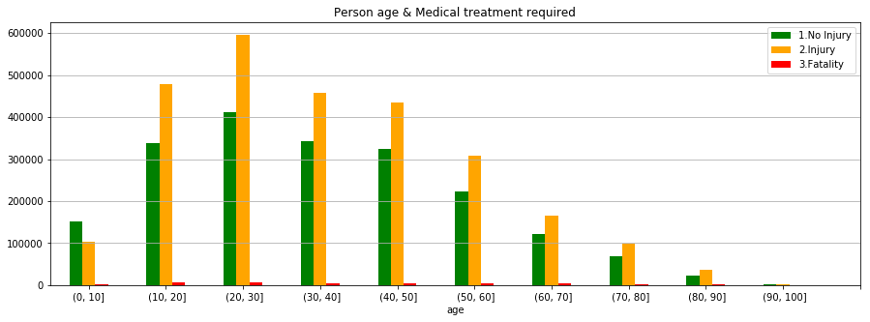
Analysis - 8. Person age

Slide 17
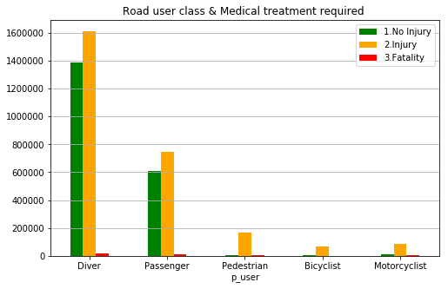
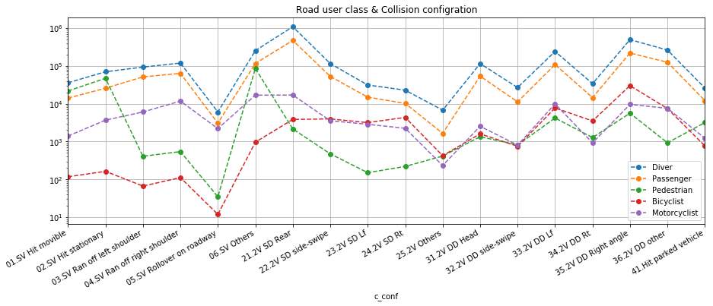
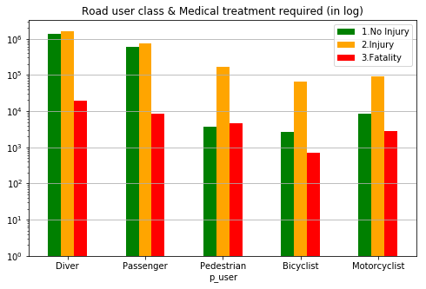
Analysis - 9. Road user class

Slide 18
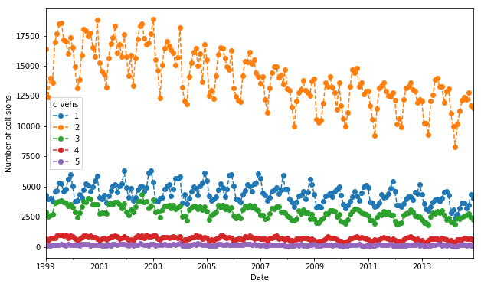
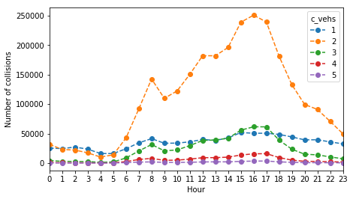
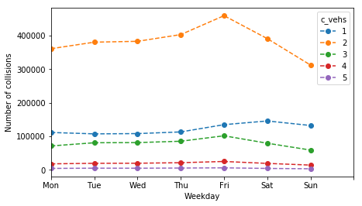
Analysis - 10. Number of Vehicles & Time relation

Slide 19
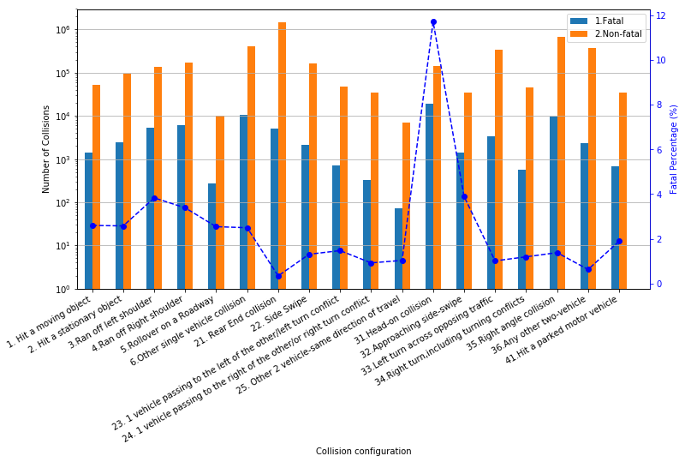
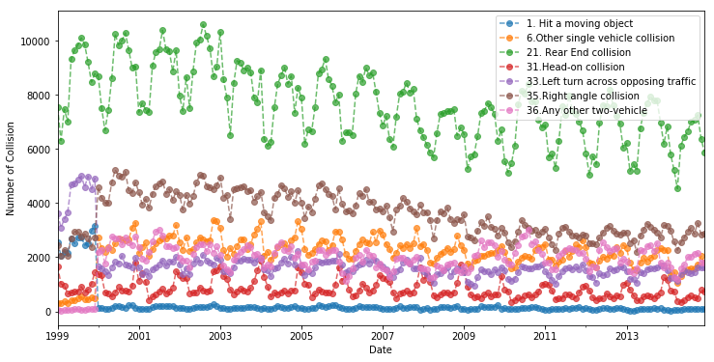
Analysis - 11. Collision Configuration

Slide 20
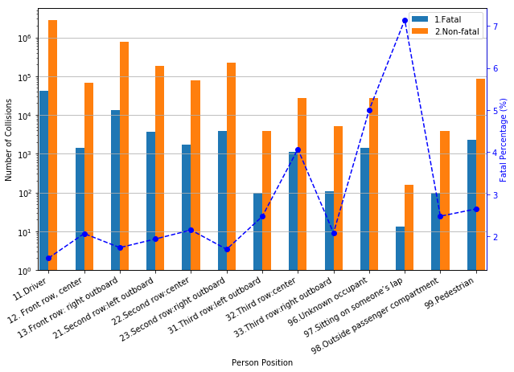
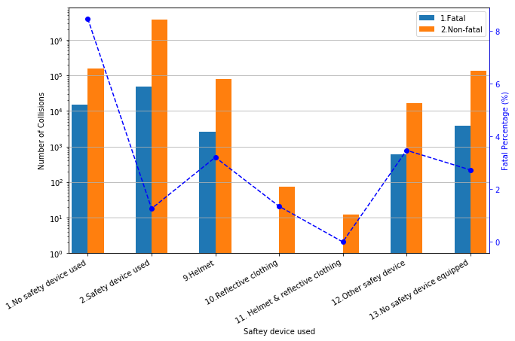
Analysis - 12. Person Position

Slide 21
Canada Car Accident 1999 - 2014
Data Preparation
Analysis
Conclusions
Appendix

Slide 22
Conclusions - Title

Slide 23
Conclusions - Title

Slide 24
Conclusions - Title

Slide 25
Conclusions - Title

Slide 26
Canada Car Accident 1999 - 2014
Data Preparation
Analysis
Conclusions
Appendix

Slide 27
Section - Title

Slide 28

Canada Car Accident 1999 - 2014

Slide 29
Canada Car Accident 1999 - 2014
Thank You

